Slide 1
Part 2
Assessing normality when you have two independent groups

Slide 2
How do we assess normality in designs with two independent groups?
1. Quantile-Quantile (Q-Q) plots
2. Shapiro-Wilk test
Data in each group should follow a normal distribution
Run these steps separately for each group

Slide 3
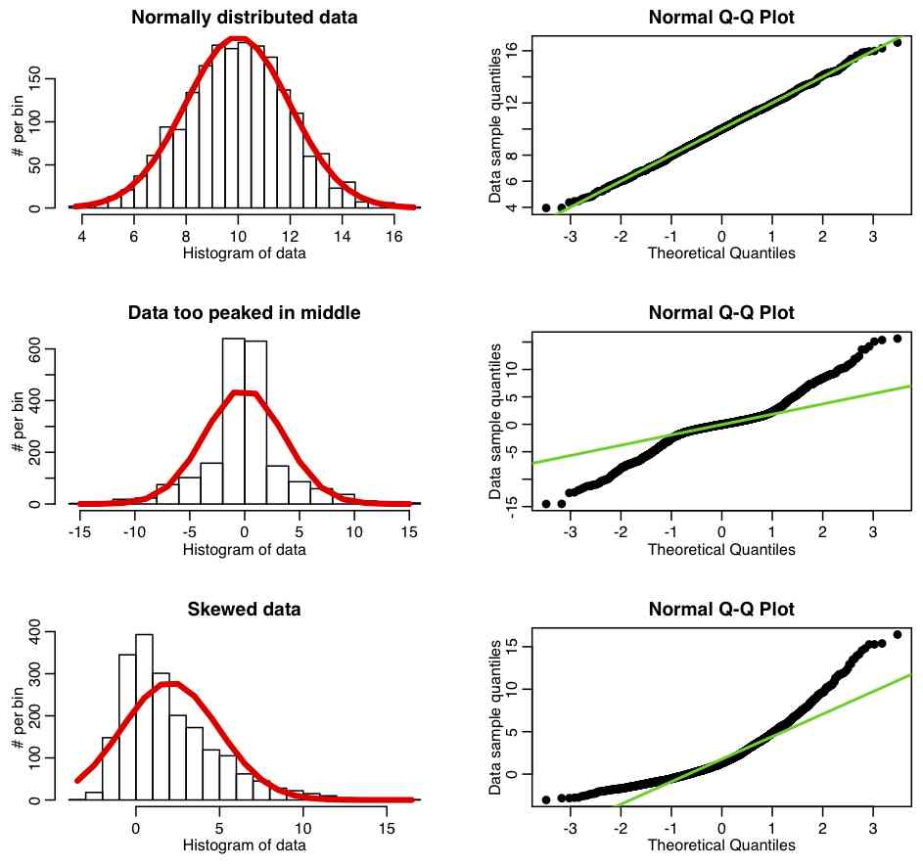
1. Q-Q plots
Plots values you would expect to get if the distribution was normal against your observed values.
Expected values are a straight diagonal line – observed values are dots
If normally distributed, dots fall mostly on top of line
Notes:
Taken from http://sherrytowers.com/2013/08/29/aml-610-fall-2013-module-ii-review-of-probability-distributions/qqplot_examples/

Slide 4
1. Quantile-Quantile plots (Q-Q plots)
If not normally distributed, points do not fall on line
Notes:
Taken from http://sherrytowers.com/2013/08/29/aml-610-fall-2013-module-ii-review-of-probability-distributions/qqplot_examples/

Slide 5
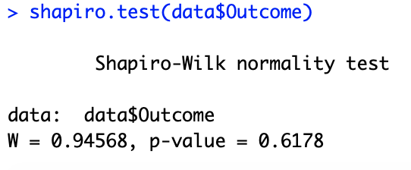

2. Shapiro-Wilk test
Test of normality
R code:
Dataframe
R output:
Function to run test
Dependent variable name

Slide 6
3. Shapiro-Wilk test - Interpretation
Conduct Shapiro-Wilk test in R and obtain p-value
p ≤ .05
p > .05
Null hypothesis: Data came from a normally distributed population
Alternative hypothesis: Data did not come from a normally distributed population
Data is NOT assumed to come from a normally distributed population
Data is assumed to come from a normally distributed population
Parametric tests not appropriate
Parametric tests may be appropriate – proceed with other assumption checks
Consider non-parametric tests

Slide 7
Which approach is better?
Shapiro-Wilk – less subjective, but likely to give significant p-values (i.e. deviations from normality) frequently with large sample sizes
Consider both outcomes together
As a general rule of thumb:
  → If the group sample size is <50, rely more on the Shapiro-Wilk test
  → If group sample size >50, rely more on Q-Q plot

Slide 8


An example
You are a researcher interested in smoking behaviours. You develop an intervention to encourage people to stop smoking.
You are interested in whether individuals in the intervention group smoke less cigarettes than individuals in the control group one week later.
Intervention:
Control:

Slide 9
The data
Does a cigarettes intervention (intervention vs control) affect the number of cigarettes consumed?
Group | Frequency
Intervention | 0
Intervention | 3
Intervention | 1
Intervention | 0
Intervention | 2
Group | Frequency
Control | 2
Control | 31
Control | 29
Control | 30
Control | 5

Slide 10
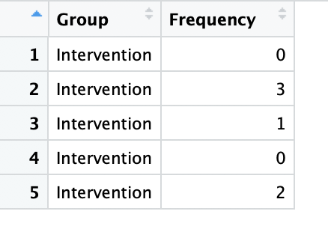
Does the data meet the normality assumption?
Intervention group
First limit the data to only the intervention group

Slide 11
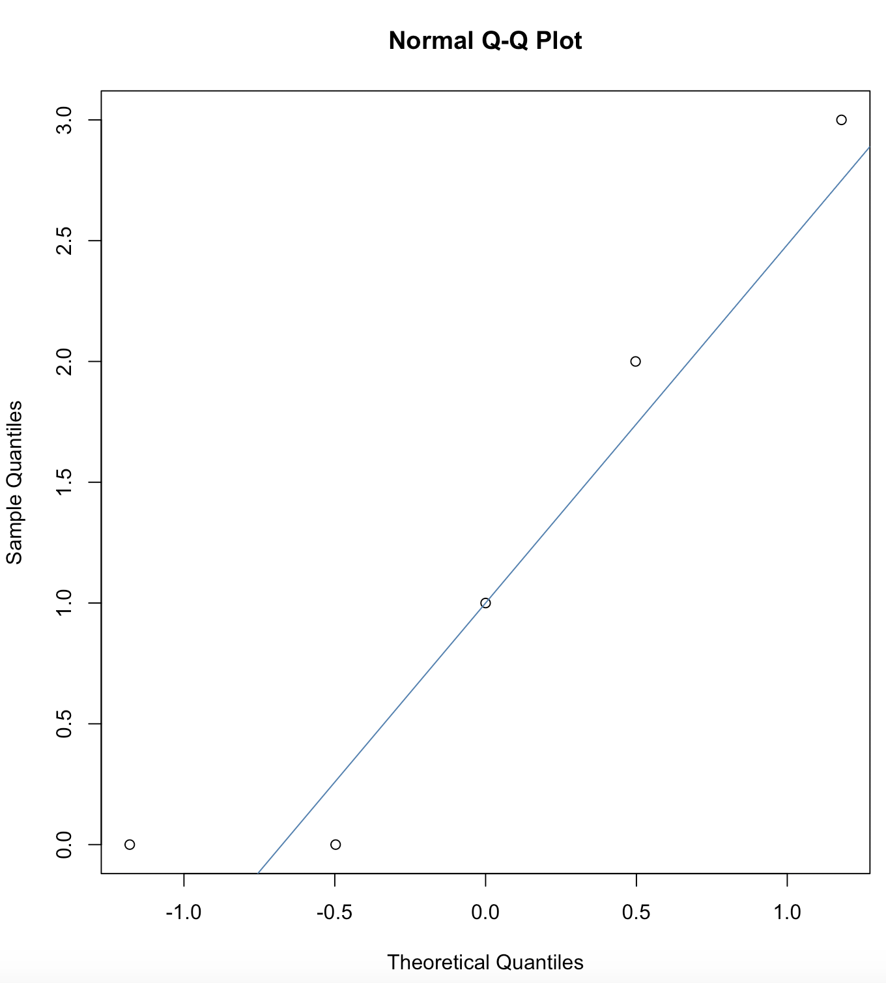
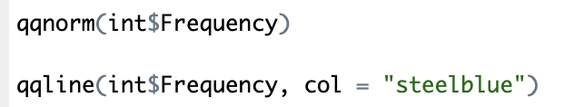
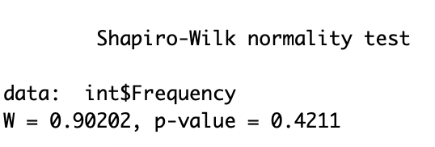

Does the data meet the normality assumption?
Intervention group
Produces dots (observed data)
Data appears to meet the normality assumption
Produces line
(expected data)

Slide 12
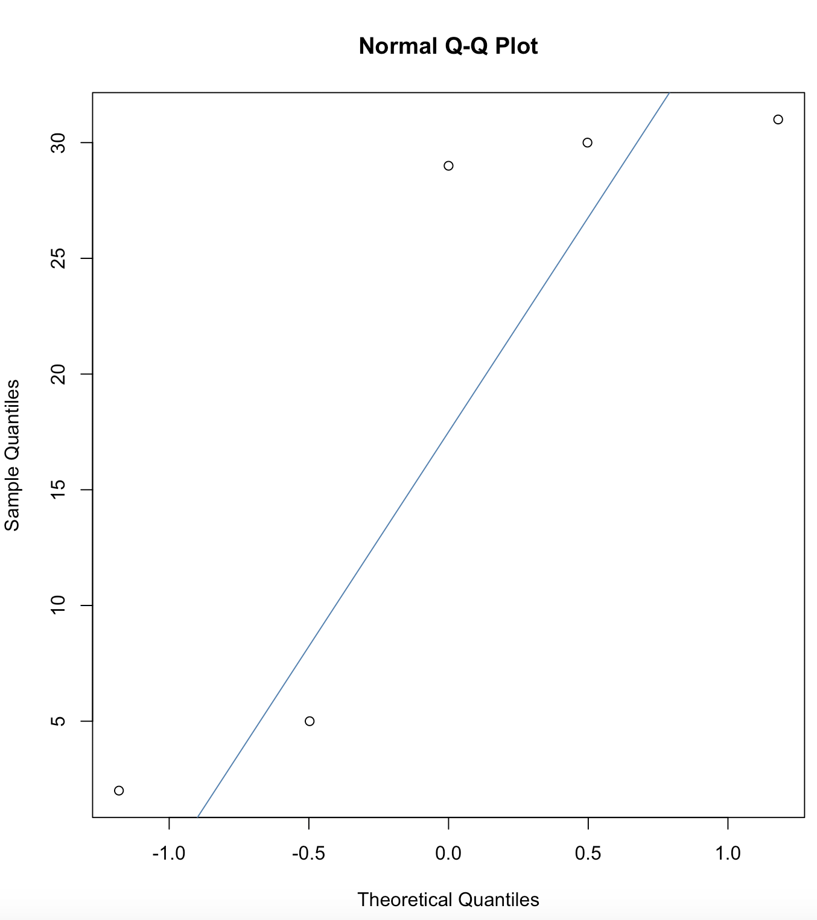
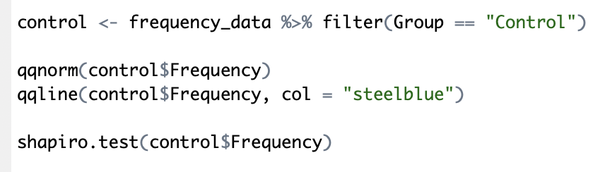
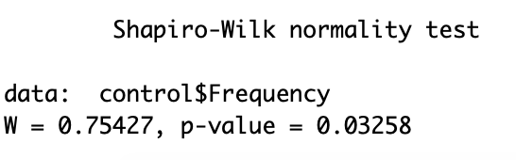
Repeat for the control group
Data does not appear to meet the normality assumption

Slide 13
Data for at least one group does not meet the normality assumption. Now what?!
Conduct the non-parametric alternative of unrelated samples t-test: the Wilcoxon rank-sum test
This test if you have a design with only two independent groups (and no repeated measures)
Also known as the Mann-Whitney test

